Slide 1
JAVA Threads, Executors, Runnables
Jeremy J. Alkire
Brigham Young University – Idaho
CIT360: Object-Oriented Software Development II
Brother Tuckett
This presentation is modeled off of the information contained in the Java™ Tutorials on the Oracle website. Further information can be found at: https://docs.oracle.com/javase/tutorial/essential/concurrency

Slide 2
Concurrency
Most computer applications are expected and required to do more than one thing at any given time. They tend to handle multiple tasks at any moment, and this multi-tasking concept is known as concurrency.
The Java Platform is designed from the ground up to support concurrent programming, with basic concurrency support in the Java programming language and the Java class libraries. Since version 5.0, the Java platform has also included high-level concurrency APIs.

Slide 3
Processes and Threads
In concurrent programming, there are two basic units of execution: processes and threads. In the Java programming language, concurrent programming is mostly concerned with threads. However, processes are also important.
A computer system normally has many active processes and threads. This is true even in systems that only have a single execution core, and thus only have one thread actually executing at any given moment. Processing time for a single core is shared among processes and threads through an OS feature called time slicing.
It's becoming more and more common for computer systems to have multiple processors or processors with multiple execution cores. This greatly enhances a system's capacity for concurrent execution of processes and threads — but concurrency is possible even on simple systems, without multiple processors or execution cores.

Slide 4
Processes
A process has a self-contained execution environment. A process generally has a complete, private set of basic run-time resources; in particular, each process has its own memory space.
Processes are often seen as synonymous with programs or applications. However, what the user sees as a single application may in fact be a set of cooperating processes. To facilitate communication between processes, most operating systems support Inter Process Communication (IPC) resources, such as pipes and sockets. IPC is used not just for communication between processes on the same system, but processes on different systems.
Most implementations of the Java virtual machine run as a single process. A Java application can create additional processes using a ProcessBuilder object.

Slide 5
Threads
Threads are sometimes called lightweight processes. Both processes and threads provide an execution environment, but creating a new thread requires fewer resources than creating a new process.
Threads exist within a process — every process has at least one. Threads share the process's resources, including memory and open files. This makes for efficient, but potentially problematic, communication.
Multithreaded execution is an essential feature of the Java platform. Every application has at least one thread — or several, if you count "system" threads that do things like memory management and signal handling. But from the application programmer's point of view, you start with just one thread, called the main thread. This thread has the ability to create additional threads, as we'll demonstrate in the next section.

Slide 6
Thread Objects
Each thread is associated with an instance of the class Thread. There are two basic strategies for using Thread objects to create a concurrent application.
To directly control thread creation and management, simply instantiate Thread each time the application needs to initiate an asynchronous task.
To abstract thread management from the rest of your application, pass the application's tasks to an executor.

Slide 7
Interfaces, Implementations, Subclasses
An interface is a class in Java that is essentially the framework for other classes that will be based upon it’s structure. It contains a number of empty method declarations that other classes will have to implement. You cannot implement the methods inside of the interface itself, another class will have to do so instead.
An implementation is a class that implements the methods defined in an interface. When creating a class that “implements” an interface, you re-define the methods inherited from the interface, and give them meaningful functionality.
A subclass is an extension of a superclass. It will inherit all members (fields, methods, and nested classes) from it’s superclass. Although it will not inherit private members of it’s parent class. That said, it can still access them through public or protected methods used for accessing them (think getter() and setter() functions). Essentially, a subclass has the ability to extend the basic functionality of it’s superclass. Additionally, a subclass can @Override methods inherited from it’s parent class, in order to give them different, custom functionality.
Additional information on subclasses and inheritance can be found at:
https://docs.oracle.com/javase/tutorial/java/IandI/subclasses.html

Slide 8
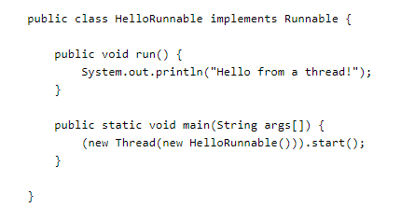
Defining and Starting a Thread (Method #1)
An application that creates an instance of Thread must provide the code that will run in that thread. There are two ways to do this:
Provide a Runnable object. The Runnable interface defines a single method, run(), meant to contain the code executed in the thread. The Runnable object is passed to the Thread constructor, as in the HelloRunnable example:

Slide 9
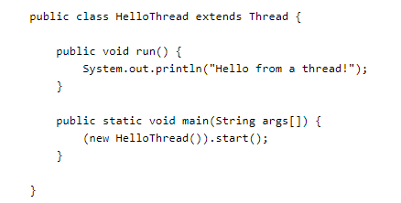
Defining and Starting a Thread (Method #2)
The second way to create an instance of Thread is to create a subclass of Thread. The Thread class itself implements Runnable, though it’s run() method does nothing. An application can subclass Thread, providing its own implementation of run(), as in the HelloThread example:

Slide 10
Interrupts
An interrupt is an indication to a thread that it should stop what it is doing and do something else. It’s up to the programmer to decide exactly how a thread responds to an interrupt, but it is very common for the thread to terminate. A thread sends an interrupt by invoking interrupt on the Thread object for the thread to be interrupted. For the interrupt mechanism to work correctly, the interrupted thread must support its own interruption.

Slide 11
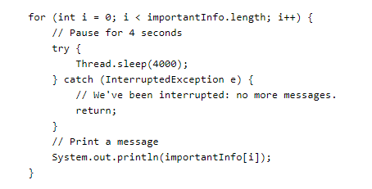
Supporting Interruption (Part 1)
How does a thread support its own interruption? This depends on what it's currently doing. If the thread is frequently invoking methods that throw InterruptedException, it simply returns from the run method after it catches that exception. For example, suppose the central message loop in the SleepMessages example were in the run method of a thread's Runnable object. Then it might be modified as follows to support interrupts:

Slide 12
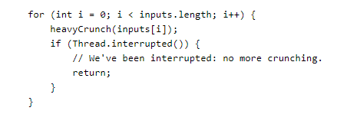

Supporting Interruption (Part 2)
Many methods that throw InterruptedException, such as sleep, are designed to cancel their current operation and return immediately when an interrupt is received.
What if a thread goes a long time without invoking a method that throws InterruptedException? Then it must periodically invoke Thread.interrupted, which returns true if an interrupt has been received. For example:
In this simple example, the code simply tests for the interrupt and exits the thread if one has been received. In more complex applications, it might make more sense to throw an InterruptedException. This allows interrupt handling code to be centralized in a catch clause:

Slide 13
Joins
The join method allows one thread to wait for the completion of another. If t is a Thread object whose thread is currently executing,
t.join();
causes the current thread to pause execution until t's thread terminates. Overloads of join allow the programmer to specify a waiting period. However, as with sleep, join is dependent on the OS for timing, so you should not assume that join will wait exactly as long as you specify.
Like sleep, join responds to an interrupt by exiting with an InterruptedException.

Slide 14
Synchronization
Threads communicate primarily by sharing access to fields and the objects reference fields refer to. This form of communication is extremely efficient, but makes two kinds of errors possible: thread interference and memory consistency errors. The tool needed to prevent these errors is synchronization.
However, synchronization can introduce thread contention, which occurs when two or more threads try to access the same resource simultaneously and cause the Java runtime to execute one or more threads more slowly, or even suspend their execution. Starvation and livelock are forms of thread contention.

Slide 15
Thread Interference
Interference happens when two operations, running in different threads, but acting on the same data, interleave. This means the two operations consist of multiple steps, and the sequences of steps overlap.
An example of this can be found at: https://docs.oracle.com/javase/tutorial/essential/concurrency/interfere.html

Slide 16
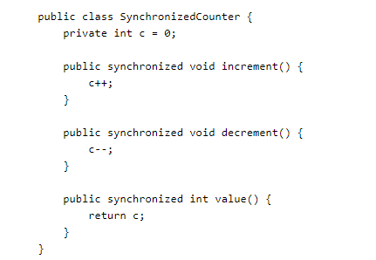
Synchronized Methods (Part 1)
The Java programming language provides two basic synchronization idioms: synchronized methods and synchronized statements. The more complex of the two, synchronized statements, are described in the next section. This section is about synchronized methods.
To make a method synchronized, simply add the synchronized keyword to its declaration:

Slide 17
Synchronized Methods (Part 2)
If count is an instance of SynchronizedCounter, then making these methods synchronized has two effects:
First, it is not possible for two invocations of synchronized methods on the same object to interleave. When one thread is executing a synchronized method for an object, all other threads that invoke synchronized methods for the same object block (suspend execution) until the first thread is done with the object.
Second, when a synchronized method exits, it automatically establishes a happens-before relationship with any subsequent invocation of a synchronized method for the same object. This guarantees that changes to the state of the object are visible to all threads.
Note that constructors cannot be synchronized — using the synchronized keyword with a constructor is a syntax error. Synchronizing constructors doesn't make sense, because only the thread that creates an object should have access to it while it is being constructed.

Slide 18
Intrinsic Locks & Synchronization
Synchronization is built around an internal entity known as the intrinsic lock or monitor lock. (The API specification often refers to this entity simply as a "monitor.") Intrinsic locks play a role in both aspects of synchronization: enforcing exclusive access to an object's state and establishing happens-before relationships that are essential to visibility.
Every object has an intrinsic lock associated with it. By convention, a thread that needs exclusive and consistent access to an object's fields has to acquire the object's intrinsic lock before accessing them, and then release the intrinsic lock when it's done with them. A thread is said to own the intrinsic lock between the time it has acquired the lock and released the lock. As long as a thread owns an intrinsic lock, no other thread can acquire the same lock. The other thread will block when it attempts to acquire the lock.
When a thread releases an intrinsic lock, a happens-before relationship is established between that action and any subsequent acquisition of the same lock.
Locks In Synchronized Methods

Slide 19
Executors
There's a close connection between the task being done by a new thread, as defined by its Runnable object, and the thread itself, as defined by a Thread object. This works well for small applications, but in large-scale applications, it makes sense to separate thread management and creation from the rest of the application. Objects that encapsulate these functions are known as executors.

Slide 20
Executor Interfaces
The java.util.concurrent package defines three executor interfaces:
Executor, a simple interface that supports launching new tasks.
ExecutorService, a subinterface of Executor, which adds features that help manage the lifecycle, both of the individual tasks and of the executor itself.
ScheduledExecutorService, a subinterface of ExecutorService, supports future and/or periodic execution of tasks.
Typically, variables that refer to executor objects are declared as one of these three interface types, not with an executor class type.

Slide 21
The Executor Interface
The Executor interface provides a single method, execute, designed to be a drop-in replacement for a common thread-creation idiom. If r is a Runnable object, and e is an Executor object you can replace
(new Thread(r)).start();
with
e.execute(r);
However, the definition of execute is less specific. The low-level idiom creates a new thread and launches it immediately. Depending on the Executor implementation, execute may do the same thing, but is more likely to use an existing worker thread to run r, or to place r in a queue to wait for a worker thread to become available. (We'll describe worker threads in the section on Thread Pools.)
The executor implementations in java.util.concurrent are designed to make full use of the more advanced ExecutorService and ScheduledExecutorService interfaces, although they also work with the base Executor interface.

Slide 22
The ExecutorService Interface
The ExecutorService interface supplements execute with a similar, but more versatile submit method. Like execute, submit accepts Runnable objects, but also accepts Callable objects, which allow the task to return a value. The submit method returns a Future object, which is used to retrieve the Callable return value and to manage the status of both Callable and Runnable tasks.
ExecutorService also provides methods for submitting large collections of Callable objects. Finally, ExecutorService provides a number of methods for managing the shutdown of the executor. To support immediate shutdown, tasks should handle interrupts correctly.

Slide 23
Thread Pools (Part 1)
Most of the executor implementations in java.util.concurrent use thread pools, which consist of worker threads. This kind of thread exists separately from the Runnable and Callable tasks it executes and is often used to execute multiple tasks.
Using worker threads minimizes the overhead due to thread creation. Thread objects use a significant amount of memory, and in a large-scale application, allocating and deallocating many thread objects creates a significant memory management overhead.
One common type of thread pool is the fixed thread pool. This type of pool always has a specified number of threads running; if a thread is somehow terminated while it is still in use, it is automatically replaced with a new thread. Tasks are submitted to the pool via an internal queue, which holds extra tasks whenever there are more active tasks than threads.
An important advantage of the fixed thread pool is that applications using it degrade gracefully. To understand this, consider a web server application where each HTTP request is handled by a separate thread. If the application simply creates a new thread for every new HTTP request, and the system receives more requests than it can handle immediately, the application will suddenly stop responding to all requests when the overhead of all those threads exceed the capacity of the system. With a limit on the number of the threads that can be created, the application will not be servicing HTTP requests as quickly as they come in, but it will be servicing them as quickly as the system can sustain.

Slide 24
Thread Pools (Part 2)
A simple way to create an executor that uses a fixed thread pool is to invoke the newFixedThreadPool factory method in java.util.concurrent.Executors This class also provides the following factory methods:
The newCachedThreadPool method creates an executor with an expandable thread pool. This executor is suitable for applications that launch many short-lived tasks.
The newSingleThreadExecutor method creates an executor that executes a single task at a time.
Several factory methods are ScheduledExecutorService versions of the above executors.
If none of the executors provided by the above factory methods meet your needs, constructing instances of java.util.concurrent.ThreadPoolExecutor or java.util.concurrent.ScheduledThreadPoolExecutor will give you additional options.

Slide 25
Further Documentation
Further documentation can be found at:
https://docs.oracle.com/javase/tutorial/essential/concurrency
A few subjects that were not covered in this presentation, but are covered in the above link, include:
Atomic Access
Liveness
Deadlock
Starvation and Livelock
Guarded Blocks
Immutable Objects
Fork/Join
Concurrent Collections
Atomic Variables
Concurrent Random Numbers

